Slide 1


Title of Project
Prepared By: Team members Name
Regd. NO: 12212380, ROLL No: 49
Course Code : CSE461
Current mobile: +91
Email: krkus18@gmail.com
Research/Project link:
Submitted To:
Dept: Computer Science and Engineering
University: Lovely Professional University Jalandhar Punjab India

Slide 2
Mentor's Thesis & PPT Approval

Slide 3
Table Of Content
1. Introduction & Project Foundation
2. Requirement Analysis & System Design
3. Data Engineering & Pre-processing
4. Advanced Methodology & Implementation
5. Comprehensive Results & Validation
6. System Integration & Deployment
7. Research Output & Intellectual Property
8. Discussion, Conclusion & Future Scope
9. References & Appendices

Slide 4
1. Introduction & Project Foundation
1.1 Project Overview: Final title, core objectives, and the "Big Picture."
1.2 Problem Statement & Motivation: The specific real-world gap addressed and why it matters.
1.3 Literature Synthesis & Research Gap: Brief recap of key existing works and the unique contribution of this project.
2. Requirement Analysis & System Design
2.1 Functional & Non-Functional Requirements: What the system does and its performance constraints.
2.2 Proposed System Architecture: High-level block diagram of the end-to-end pipeline.
2.3 Data Flow & Workflow: DFD or Flowcharts illustrating the movement of data.
3. Data Engineering & Pre-processing
3.1 Data Sourcing & Description: Dataset details (size, features, source).
3.2 Exploratory Data Analysis (EDA): Key statistical insights and visualizations (Correlations, Outliers).
3.3 Data Pipeline: Cleaning, Feature Engineering (Selection/Scaling/Encoding), and Splitting strategies.
4. Advanced Methodology & Implementation
4.1 Final Algorithm Selection: Logic behind choosing the production-ready model (e.g., Why XGBoost over Random Forest?).
4.2 Mathematical Modeling: The core formulas, loss functions, or logic governing the system.
4.3 Hyperparameter Optimization: Results from tuning (GridSearch/Optuna) to reach peak performance.
5. Comprehensive Results & Validation
5.1 Performance Evaluation: Final metrics (Accuracy, F1-Score, ROC-AUC, RMSE) with graphical representations.
5.2 Comparative Analysis: How the final model compares against baseline models.
5.3 Ablation Study: Analysis of how individual components/features contributed to the final result.
6. System Integration & Deployment
6.1 Final UI/UX Implementation: Screenshots and demo of the functional application (e.g., Tkinter GUI or Web App).
6.2 Deployment Pipeline: How the model is served (API, Cloud, or Local Pickle) and its real-world latency.
7. Research Output & Intellectual Property
7.1 Research Paper/Publication: Status of the manuscript and target journal/conference (IEEE/Springer/Scopus).
7.2 IP & Copyright: Details on Patent filing or Software Copyright for unique logic/GUI.(OPTIONAL)
8. Discussion, Conclusion & Future Scope
8.1 Technical Challenges & Mitigations: Reflections on hurdles overcome during the semester.
8.2 Limitations & Constraints: Honest assessment of the system’s boundaries.
8.3 Conclusion & Future Directions: Impact on the target domain and potential for multi-modal or large-scale expansion.
9. References & Appendices
9.1 Bibliography: Standard APA/IEEE citations.
9.2 Plagiarism/Similarity Report: Evidence of original work.

Slide 5
Introduction (Font Size need to follow)
To build computational skills through hands-on and practice-based learning with measurable outcomes.
To establish a strong connect with industry for in-demand technology driven curriculum.
To build the infrastructure for meaningful research around societal problems.
To nurture future leaders through research-infused education and lifelong learning.
To create smart and ethical professionals and entrepreneurs who are recognized globally.

Slide 8
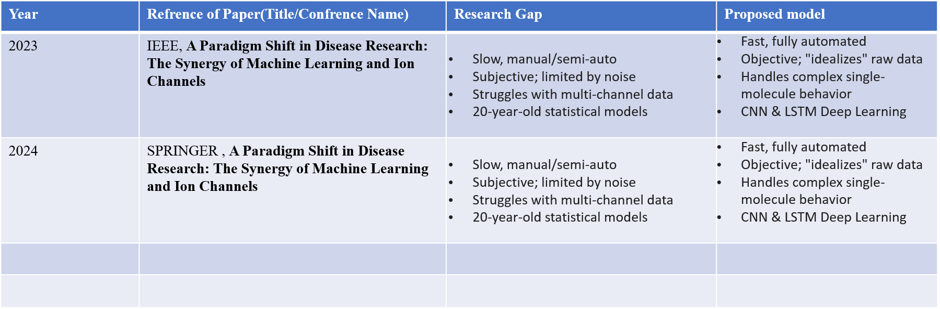
Literature review and Research Gap

Slide 9
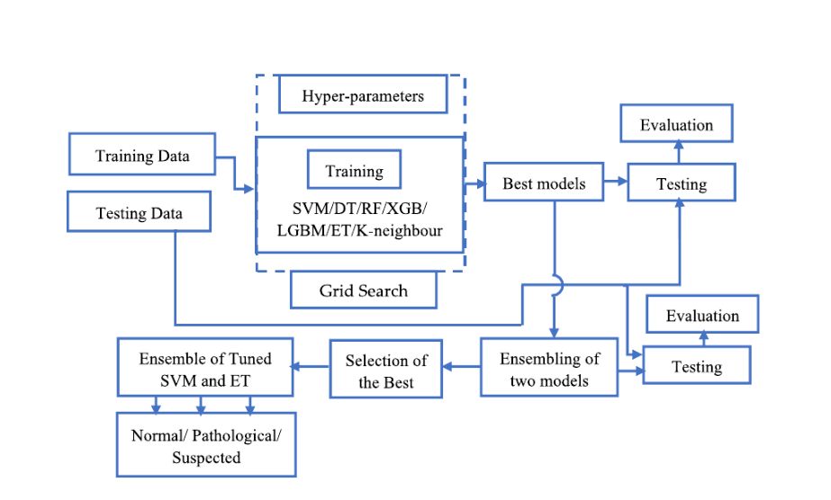
Don’t copy paste DFD or Flowcharts, create your own

Slide 10
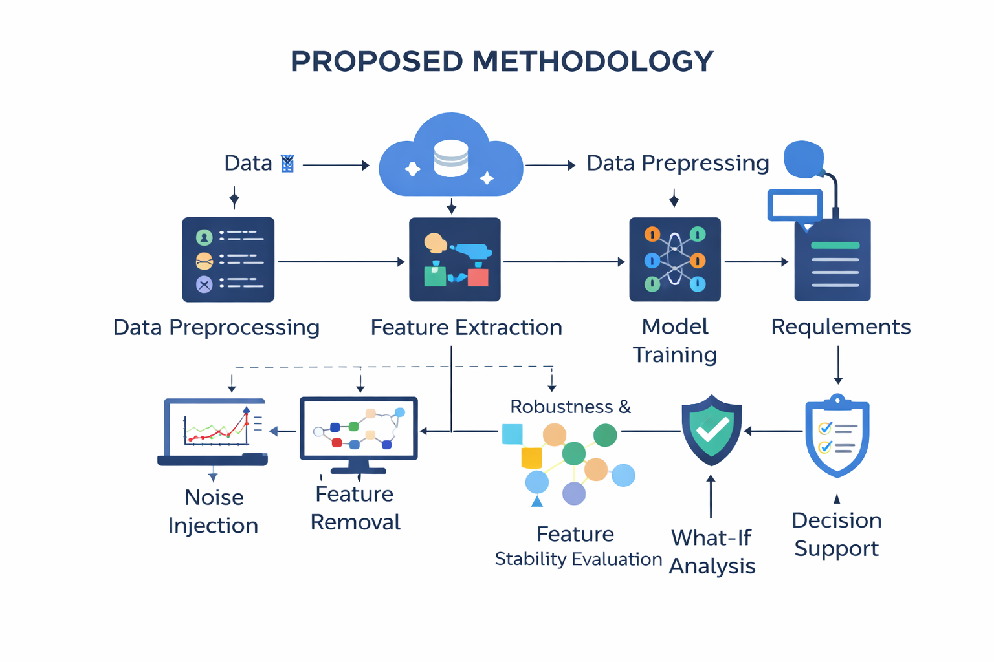
Final proposed system architecture

Slide 13
Screenshots and demo of the functional application
Screenshots and demo of the functional application

Slide 14
Project Timeline

Slide 15
References(APA)
A. Research Papers (Journals/Conferences)
Format: [Ref No.] Author(s), "Title of Paper," Title of Journal/Conference, Vol., No., pp. Page numbers, Month, Year.
Example: [1] A. Sharma and R. Goel, "A Comparative Analysis of Machine Learning Algorithms for Predictive Analytics," International Journal of Computer Applications, Vol. 178, No. 12, pp. 22-29, Oct. 2025.
B. Books
Format: [Ref No.] Author(s), Title of the Book, Edition (if any). City, State/Country: Publisher, Year.
Example: [2] T. Cormen, C. Leiserson, and R. Rivest, Introduction to Algorithms, 3rd ed. Cambridge, MA, USA: MIT Press, 2009.
C. Websites / Online Documentation
Format: [Ref No.] Author/Organization, "Title of Page," Year. [Online]. Available: URL. [Accessed: Date].
Example: [3] Scikit-Learn Developers, "Supervised Learning - Comparison of Algorithms," 2024. [Online]. Available: https://scikit-learn.org/stable/supervised_learning.html. [Accessed: Jan. 15, 2026].

Slide 16
Research paper status

Slide 17
Research plagrism report

Slide 18
Evidence of original work(ppt plag report <10%)

Slide 19
Additional research work done
01. “BOOK CHAPTER TITLE” , where “BOOK NAME” and the publisher's “NAME”.
02. “CONFERENCE PAPER”, Where “Conference NAME” and “Other Details. ”
03. ……..
04. ………

